Slide 1









Whiteboardmaths.com
7
2
1
5
© 2004 All rights reserved

Slide 2
Angles In Triangles
Types of Triangles
Equilateral Triangle
Isosceles triangle
Scalene triangle
3 equal sides
3 equal angles.
2 equal sides
2 equal angles (base)
3 unequal sides
3 unequal angles

Slide 3
Any triangle containing a 90º angle is a right-angled triangle
An isosceles or a scalene triangle may contain a right angle.
Right-angled
isosceles triangles.
Right-angled
scalene triangle.

Slide 4
To determine the angle sum of any Triangle
How can we use this to help us?
Take 3 identical copies of this triangle like so:
3
1
2
These are the same angles as in the triangle!
Angles on a straight line add to 180º
The angle sum of a triangle = 180⁰

Slide 5
Calculating unknown Angles
Example 1
Calculate angle a.
65º
a
Angle a = 180 – (90 + 65)
= 180 – 155 = 25º
Example 2
b
Calculate angles a, b and c
a
c
Since the triangle is equilateral,
angles a, b and c are all 60º (180/3)

Slide 6
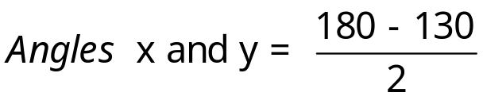
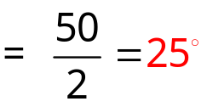
Calculating unknown Angles
Example 3
b
Angle a = 65º (base angles of an isosceles triangle are equal).
Calculate angle a.
Angle b = 180 –(65 + 65)
= 180 – 130 = 50º
65º
a
Example 4
130º
Calculate angles x and y
x
y

Slide 7
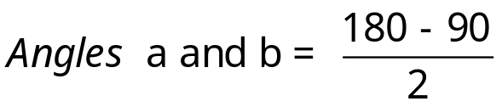
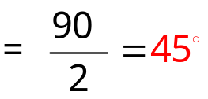
Calculating unknown Angles
Example 5
Calculate angles a and b.
a
b
Example 6
27º
Calculate angle a
15º
a
Angle a = 180 – (15 + 27)
= 180 – 42 = 138º

